Slide 1


ESPORTS TOURNAMENT
DATA ANALYSIS USING SQL

Slide 2
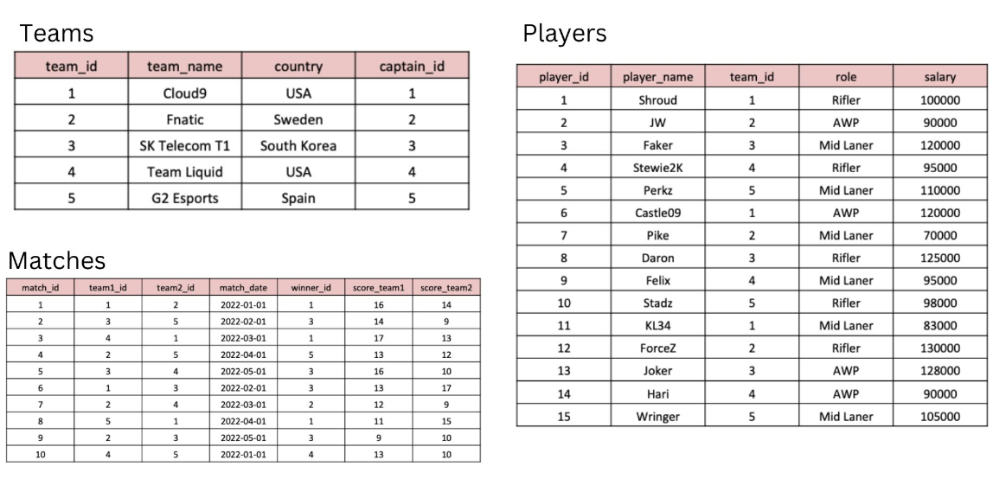
TABLES

Slide 3
SQL SCHEMA
CREATE TABLE Teams (
team_id INT PRIMARY KEY,
team_name VARCHAR(50) NOT NULL,
country VARCHAR(50),
captain_id INT
);
--------------------
INSERT INTO Teams (team_id, team_name, country, captain_id)
VALUES (1, 'Cloud9', 'USA', 1),
(2, 'Fnatic', 'Sweden', 2),
(3, 'SK Telecom T1', 'South Korea', 3),
(4, 'Team Liquid', 'USA', 4),
(5, 'G2 Esports', 'Spain', 5);
--------------------
CREATE TABLE Players (
player_id INT PRIMARY KEY,
player_name VARCHAR(50) NOT NULL,
team_id INT,
role VARCHAR(50),
salary INT,
FOREIGN KEY (team_id) REFERENCES Teams(team_id)
);

Slide 4
SQL SCHEMA
INSERT INTO Players (player_id, player_name, team_id, role, salary)
VALUES (1, 'Shroud', 1, 'Rifler', 100000),
(2, 'JW', 2, 'AWP', 90000),
(3, 'Faker', 3, 'Mid laner', 120000),
(4, 'Stewie2k', 4, 'Rifler', 95000),
(5, 'Perkz', 5, 'Mid laner', 110000),
(6, 'Castle09', 1, 'AWP', 120000),
(7, 'Pike', 2, 'Mid Laner', 70000),
(8, 'Daron', 3, 'Rifler', 125000),
(9, 'Felix', 4, 'Mid Laner', 95000),
(10, 'Stadz', 5, 'Rifler', 98000),
(11, 'KL34', 1, 'Mid Laner', 83000),
(12, 'ForceZ', 2, 'Rifler', 130000),
(13, 'Joker', 3, 'AWP', 128000),
(14, 'Hari', 4, 'AWP', 90000),
(15, 'Wringer', 5, 'Mid laner', 105000);
--------------------
CREATE TABLE Matches (
match_id INT PRIMARY KEY,
team1_id INT,
team2_id INT,
match_date DATE,

Slide 5
SQL SCHEMA
winner_id INT,
score_team1 INT,
score_team2 INT,
FOREIGN KEY (team1_id) REFERENCES Teams(team_id),
FOREIGN KEY (team2_id) REFERENCES Teams(team_id),
FOREIGN KEY (winner_id) REFERENCES Teams(team_id)
);
--------------------
INSERT INTO Matches (match_id, team1_id, team2_id, match_date, winner_id, score_team1, score_team2)
VALUES (1, 1, 2, '2022-01-01', 1, 16, 14),
(2, 3, 5, '2022-02-01', 3, 14, 9),
(3, 4, 1, '2022-03-01', 1, 17, 13),
(4, 2, 5, '2022-04-01', 5, 13, 12),
(5, 3, 4, '2022-05-01', 3, 16, 10),
(6, 1, 3, '2022-02-01', 3, 13, 17),
(7, 2, 4, '2022-03-01', 2, 12, 9),
(8, 5, 1, '2022-04-01', 1, 11, 15),
(9, 2, 3, '2022-05-01', 3, 9, 10),
(10, 4, 5, '2022-01-01', 4, 13, 10);

Slide 6
QUESTIONS
1. What are the names of the players whose salary is greater than 100,000?
2. What is the team name of the player with player_id = 3?
3. What is the total number of players in each team?
4. What is the team name and captain name of the team with team_id = 2?
5. What are the player names and their roles in the team with team_id = 1?
6. What are the team names and the number of matches they have won?
7. What is the average salary of players in the teams with country 'USA'?
8. Which team won the most matches?
9. What are the team names and the number of players in each team whose salary is greater than 100,000?
10. What is the date and the score of the match with match_id = 3?

Slide 7
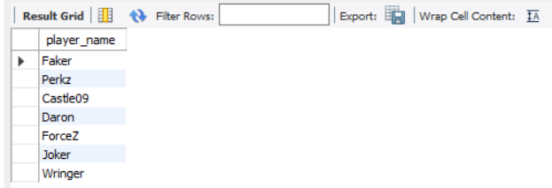
What are the names of the players whose salary is greater than 100,000?
SELECT player_name FROM players
WHERE salary > 100000;

Slide 8

What is the team name of the player with player_id = 3?
SELECT team_name FROM teams
JOIN players ON players.team_id = teams.team_id
WHERE player_id = 3;

Slide 9
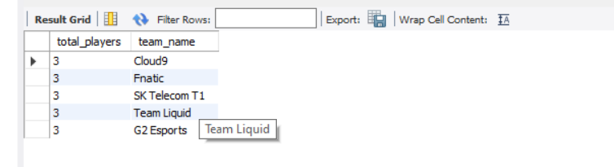
What is the total number of players in each team?
SELECT COUNT(player_id) AS total_players, team_name FROM teams
JOIN players ON players.team_id = teams.team_id
GROUP BY teams.team_name;

Slide 10
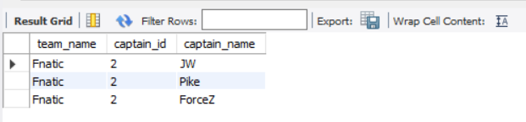
What is the team name and captain name of the team with team_id = 2?
SELECT team_name, captain_id, player_name AS captain_name FROM teams
JOIN players ON players.team_id = teams.team_id
WHERE teams.team_id = 2;

Slide 11
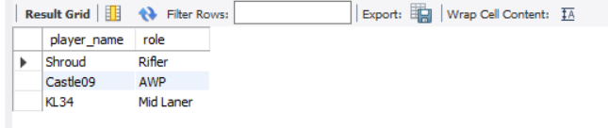
What are the player names and their roles in the team with team_id = 1?
SELECT player_name, role FROM players
JOIN teams ON players.team_id = teams.team_id
WHERE teams.team_id = 1;

Slide 12
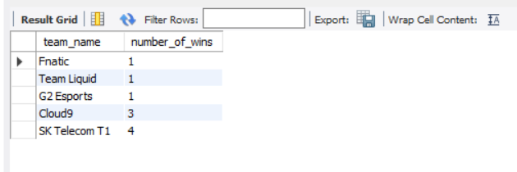
What are the team names and the number of matches they have won?
SELECT team_name, COUNT(*) AS number_of_wins FROM teams
JOIN matches ON teams.team_id = matches.winner_id
GROUP BY winner_id
ORDER BY number_of_wins;

Slide 13
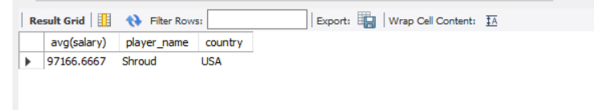
What is the average salary of players in the teams with country 'USA’?
SELECT AVG(salary), player_name, country FROM players
JOIN teams ON players.team_id = teams.team_id
WHERE country = 'USA';

Slide 14
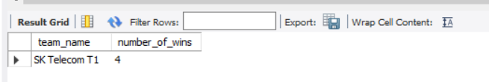
Which team won the most matches?
SELECT team_name, COUNT(winner_id) AS number_of_wins from teams
JOIN matches ON teams.team_id = matches.winner_id
GROUP BY winner_id
ORDER BY number_of_wins desc LIMIT 1;

Slide 15
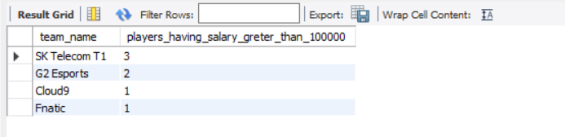
What are the team names and the number of players in each team whose salary is greater than 100,000?
SELECT team_name, COUNT(*) AS salary_greater_than_100000 FROM teams
JOIN players ON teams.team_id = players.team_id
WHERE salary > 100000
GROUP BY team_name;

Slide 16
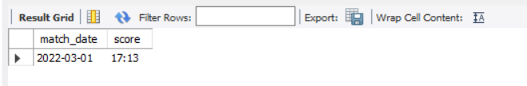
What is the date and the score of the match with match_id = 3?
SELECT match_date, CONCAT(score_team1, ':' ,score_team2) AS score FROM matches
WHERE match_id = 3;

